Slide 1

Song Genre Prediction
Data Mining I Project

Slide 2
Overview
1. Data Exploration
2. Preprocessing
3. Machine Learning Methods
4. Results

Slide 3


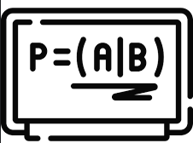

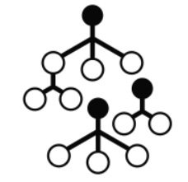

Goal
Data Exploration
KNN
Naive Bayes
SVM
Song Data
Model
Song Genre
Random Forest
Decision Tree
Generate a model that can accurately predict the genre of a song given certain attributes about the track.

Slide 4
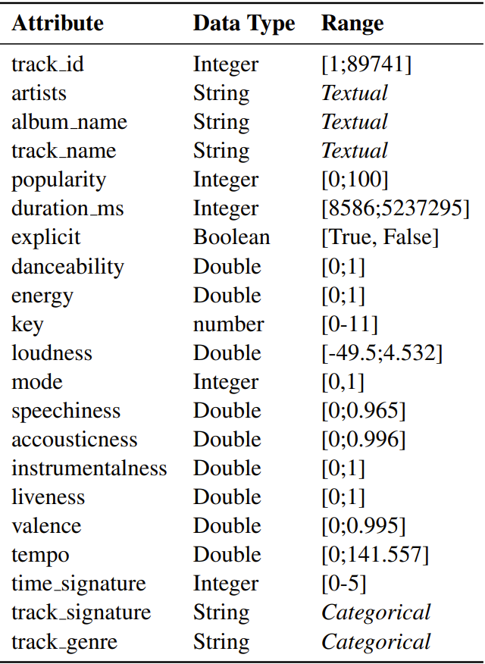





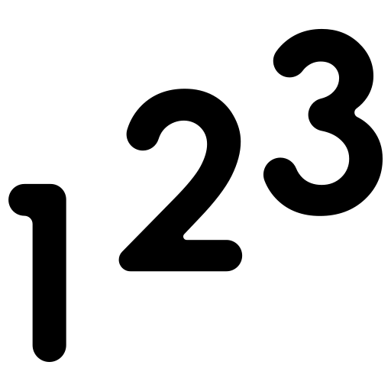
Dataset
Data Exploration
18 features
114k songs
4 categorical
Features
3 string
114 genres
11 continuous
Label

Slide 5
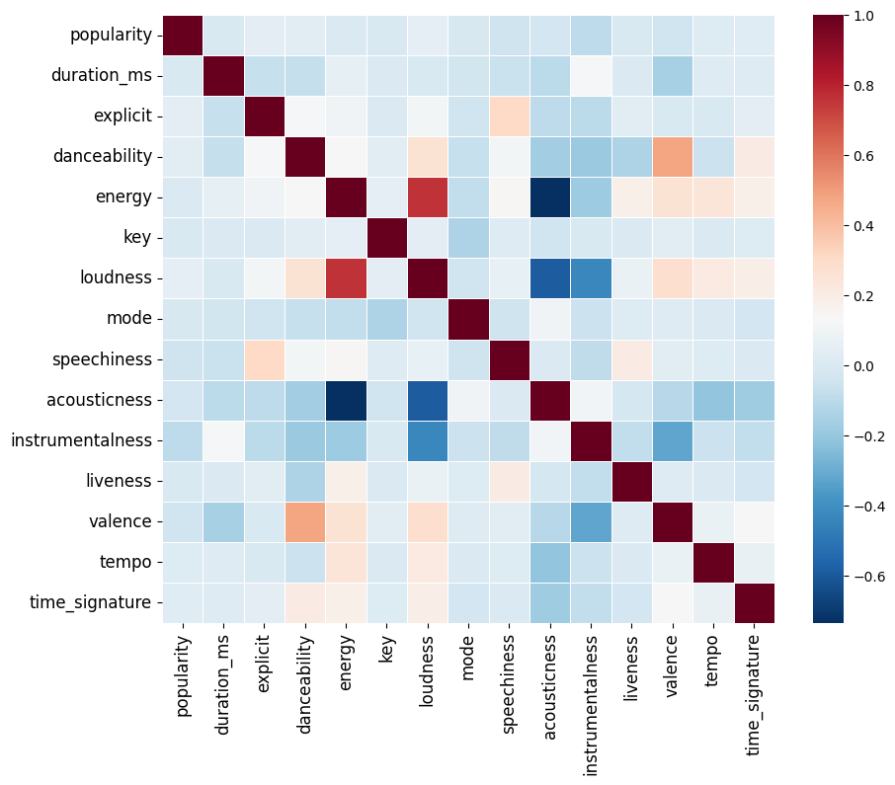
Correlation analysis
Data Exploration

Slide 6

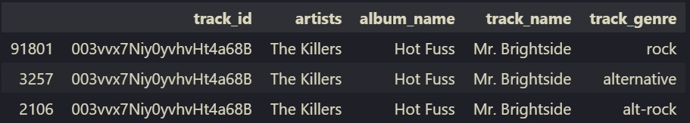
Duplicates
Preprocessing
16.000 songs in the dataset have multiple genres (21.3% of the dataset)

Slide 7


Dealing with Duplicates
Preprocessing
2 Solutions implemented
Random selection
Similarity-based selection

Slide 8
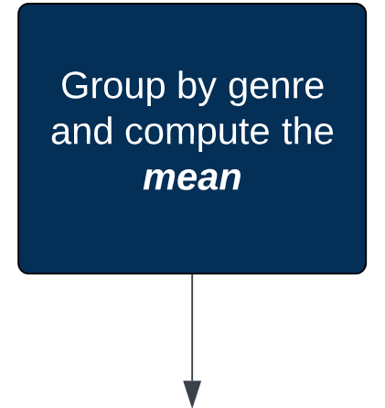
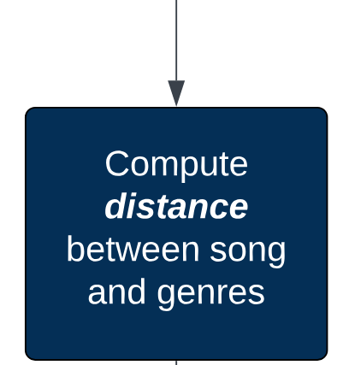
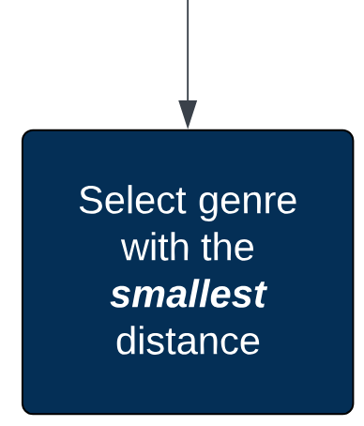
Similarity-based selection
Preprocessing
Example: Mr. Brightside = [rock, alt-rock]
Rock = [0.2 0.8 1 0.15 …]
Alt-rock = [0.4 0.5 0.6 0.2 …]
Song = [0.3 0.7 0.9 0.1 …]
Distance rock = 0.35
Distance alt-rock = 0.7
Mr. Brightside = rock
Notes:
Rock

Slide 9
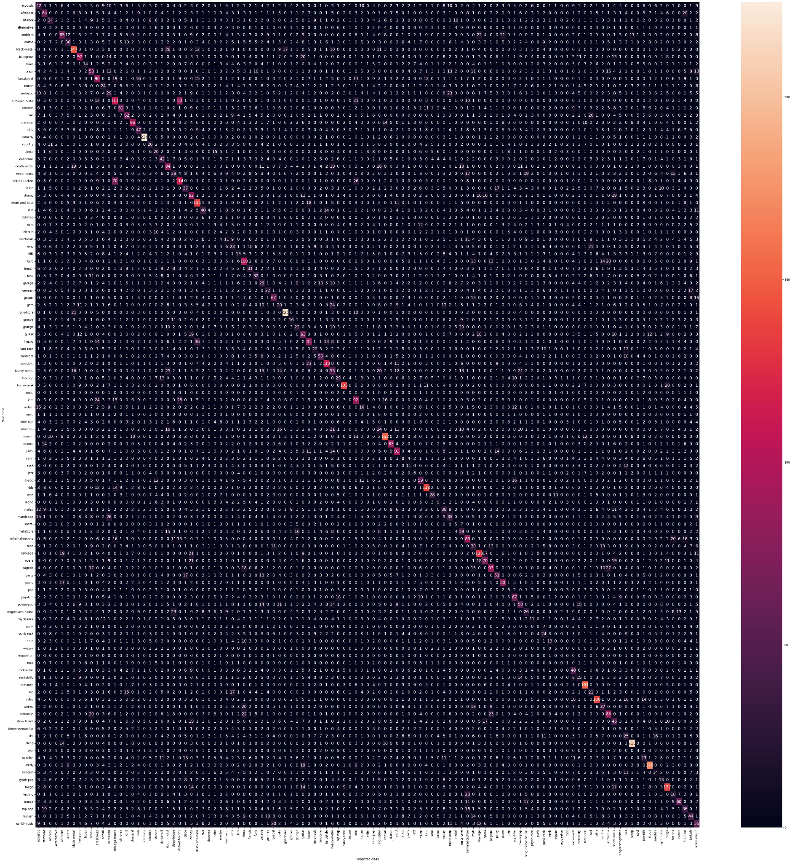
Problem with the Label
Preprocessing
114 labels make it hard to visualize
Some genres are very similar to each other
For instance:
Techno
Minimal Techno
Detroit Techno
→ We can form groups

Slide 10
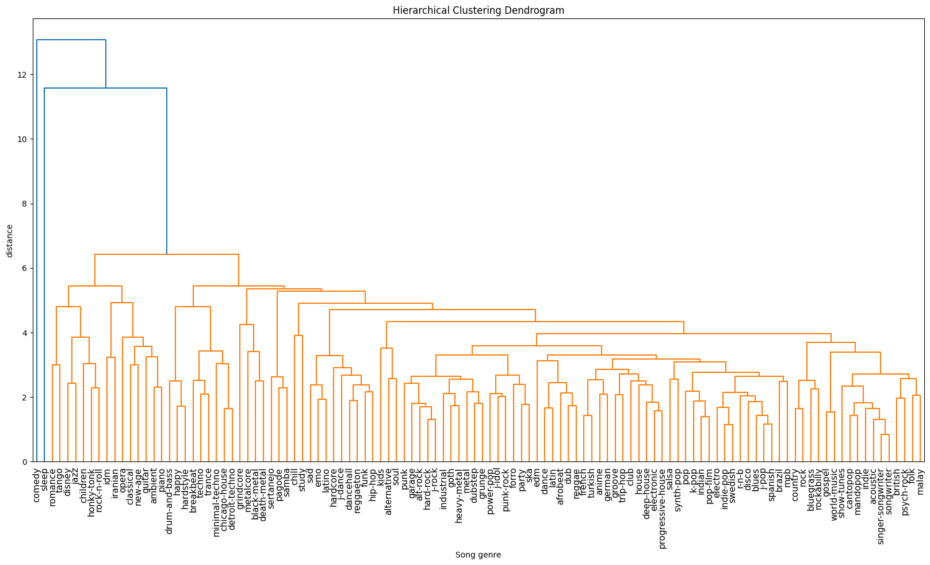
Using hierarchical clustering for grouping
Preprocessing

Slide 11
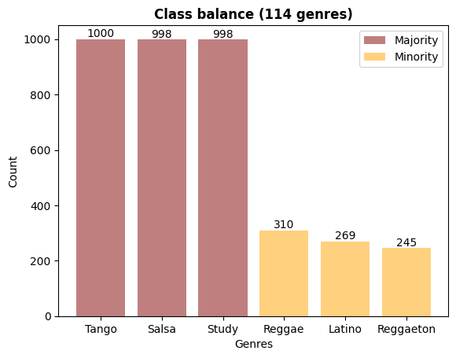
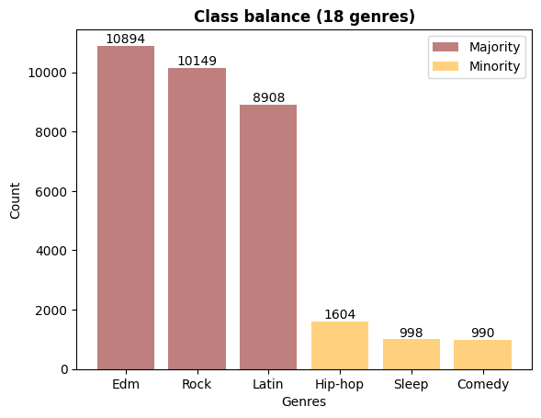
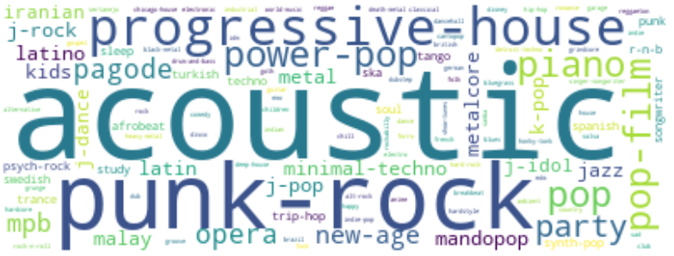
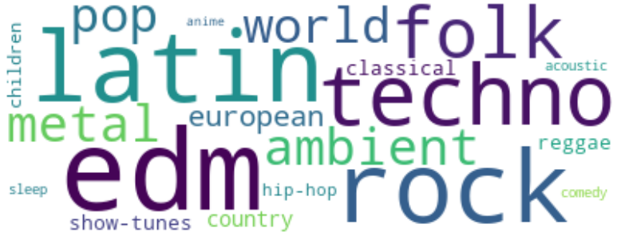
Simplified dataset
Preprocessing

Slide 12
Training procedure
Preprocessing
Feature Generation
Splitting
Scaling
Grid Search
Testing

Slide 13
Feature Generation - TFIDF
Preprocessing
Top 5 generated features from artists
Feature | Score
los | 0.003832
mc | 0.002628
pritam | 0.002394
wolfgang | 0.001895
zimmer | 0.001449

Slide 14


Different Approaches
Machine Learning Methods
Base Model
KNN
Naive Bayes
SVM
Decision Tree
Random Forest

Slide 15
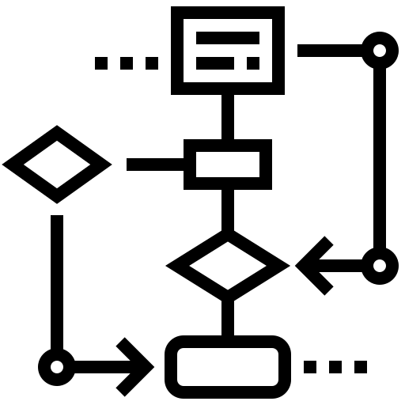
Baselines
Machine Learning Methods
Majority class
Rule-based
if ‘energy’ > 0.75
return ‘techno’
elif ‘valence’ < 0.6
return ‘sleep’
.
.
.

Slide 16
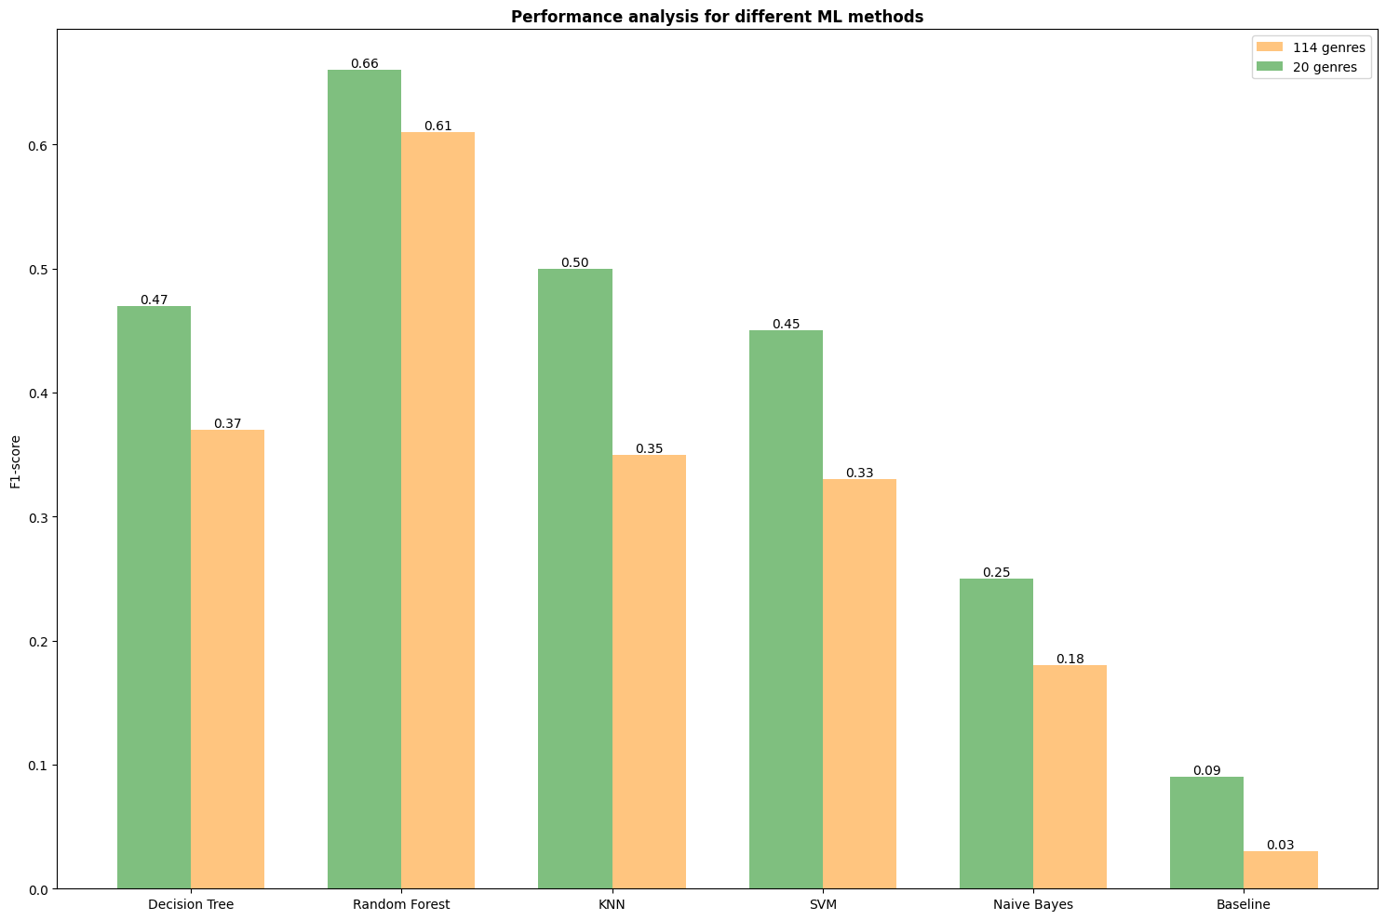
Performance Measure
Machine Learning Methods

Slide 17
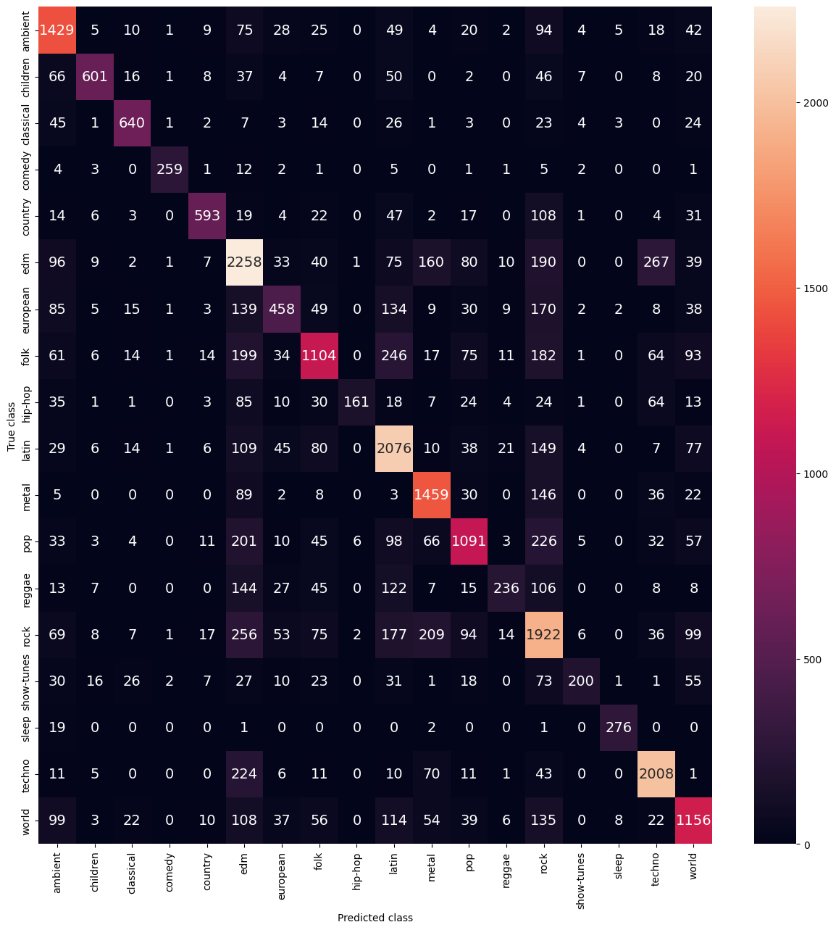
Confusion Matrix
Machine Learning Methods

Slide 18
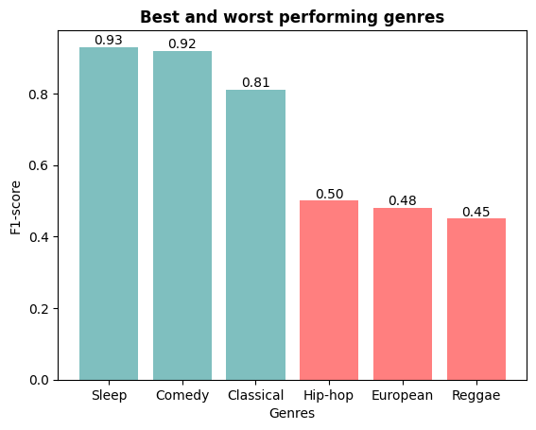
Performance by genre
Machine Learning Methods

Slide 19
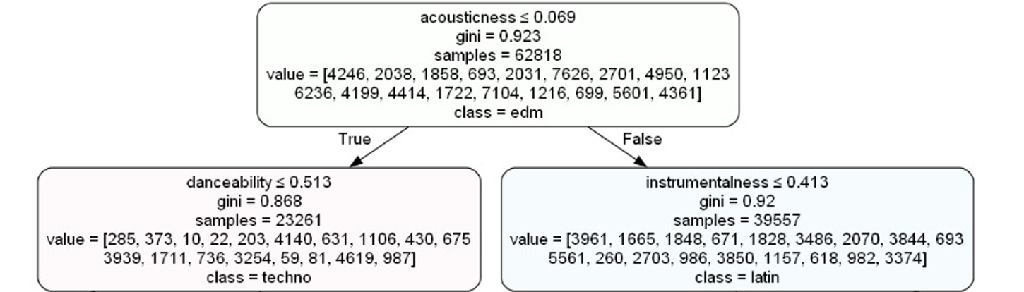
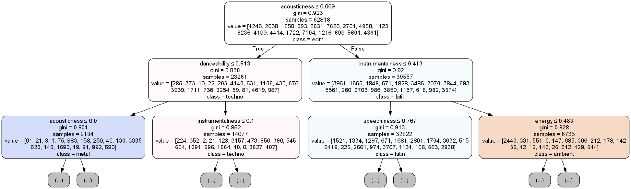
Decision Tree
Machine Learning Methods
Notes:
Note: Original length is 37. With author it is 84.

Slide 20

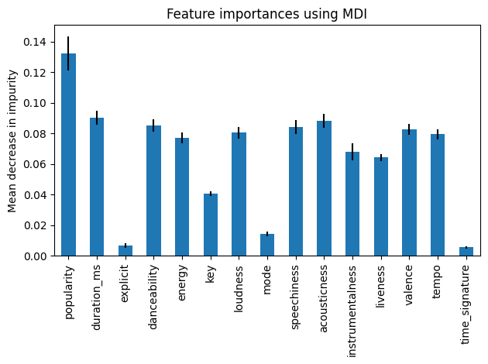
Random Forest
Data Exploration
Results
Machine Learning Methods

Slide 21
Conclusions & Further Work
Results
Conclusion
Better performance when compared to the baseline
Incorrect/questionable assignment of genres in our original data set, could have made an impact on our model. (e.g. Hans Zimmer German Music)
Future Work
Multilabel classification
Extract more feature data (e.g. lyrics)

Slide 22
References
https://www.kaggle.com/datasets/maharshipandya/-spotify-tracks-dataset

